Slide 1


Network protocols & security
24EC2210
Topic:
IP Addressing: CLASSFUL & CLASSLESS Addressing
Session – 14

Slide 2



AIM OF THE SESSION
To familiarize students with the concept of IP Addressing
INSTRUCTIONAL OBJECTIVES
This Session is designed to:
Describe the concepts of Classful addressing.
Describe the concepts of Classless addressing.
LEARNING OUTCOMES
At the end of this session, you should be able to:
Solve the IP addressing problems related to Classful addressing.
Solve the IP addressing problems related to Classless addressing.

Slide 3
AGENDA
IP Address​es
IPv4 Address Space
Notations
Classful Addressing
Classless Addressing
IPv6
Addressing Methods

Slide 4
IP ADDRESSES
An IP address is a numeric identifier assigned to each machine on an IP network.
An IP address is a software or logical address, and it designates the specific location of a device on the network.
IP addressing was designed to allow hosts on one network to communicate with a host on a different network regardless of the type of LANs the hosts are participating in.
Versions: IPv4 and IPv6

Slide 5
IPv4 ADDRESSES
An IPv4 address is a 32-bit address that uniquely and universally defines the connection of a device (for example, a computer or a router) to the Internet..
Topics discussed in this section:
1. Address Space
2. Notations
3. Classful Addressing
4. Classless Addressing

Slide 6
1. Address SPACE
The total number of addresses used by the protocol. If a protocol uses N bits to define an address, the address space is 2^{N} because each bit can have two different values (0 or 1) and N bits can have 2^{N} values.
The address space of IPv4 is 2³² or 4,294,967,296.
The address space of IPv6 is 2¹²⁸ or 40,282,366,920,938,463,463,374,607,431,768,211,456.

Slide 7
2. NOTATIONS
There are two prevalent notations to show an IPv4 address:
Dotted-Decimal notation
Binary notation
Hexadecimal notation
2. a. Dotted-Decimal Notation
To make the IPv4 address more compact and easier to read, Internet addresses are usually written in decimal form with a decimal point (dot) separating the bytes.
The following is the dotted-decimal notation of an address: 132.11.3.31

Slide 8
2. NOTATIONS (contd…)
2.b. Binary notation
In binary notation, the IPv4 address is displayed as 32 bits.
Each octet is often referred to as a byte.
it is common to hear an IPv4 address referred to as a 32-bit address or a 4-byte address.
The following is an example of an IPv4 address in binary notation

Slide 9
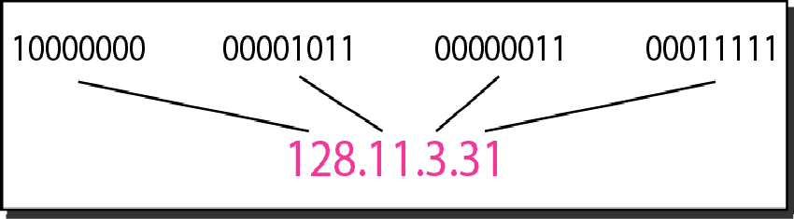
Dotted-decimal notation and binary notation for an IPv4 address

Slide 10
2. NOTATIONS (contd…)
2.c. Hexadecimal notation
The IPv4 address is displayed as 8 hexadecimal digits.
Example: 10000001 00001011 00001011 11101111
Hexadecimal notation is: 810B0BEF₁₆

Slide 11
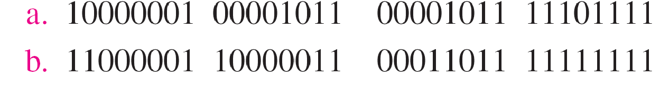
Example
Change the following IPv4 addresses from binary notation to dotted-decimal notation.

Slide 12
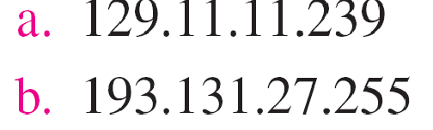
Example
Change the following IPv4 addresses from binary notation to dotted-decimal notation.
Solution
We replace each group of 8 bits with its equivalent decimal number and add dots for separation

Slide 13
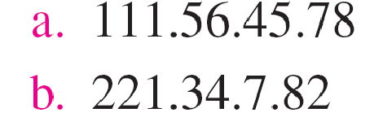
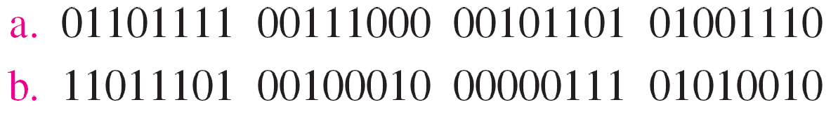
Example
Change the following IPv4 addresses from dotted-decimal notation to binary notation.
Solution
We replace each decimal number with its binary equivalent

Slide 14
IPv4 Address Rules
RULES:
1. There must be no leading zero
2. There can be no more than four bytes in IPV4 address
3. Each number must be less than or equal to 255
4. A mixture of binary and decimal notation is not allowed.

Slide 15
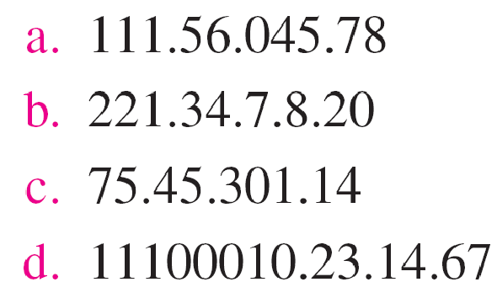
Example
Find the error, if any, in the following IPv4 addresses.
Solution
There must be no leading zero (045).
There can be no more than four numbers.
Each number needs to be less than or equal to 255.
A mixture of binary notation and dotted-decimal notation is not allowed.

Slide 16
3. Classful addressing
IPv4 addressing, at its inception, used the concept of classes.
The address space is divided into five classes: A, B, C, D, and E. Each class occupies some part of the address space
We can find the class of an address when given the address in binary notation or dotted- decimal notation.
If the address is given in binary notation, the first few bits can immediately tell us the class of the address.
If the address is given in decimal-dotted notation, the first byte defines the class.

Slide 17
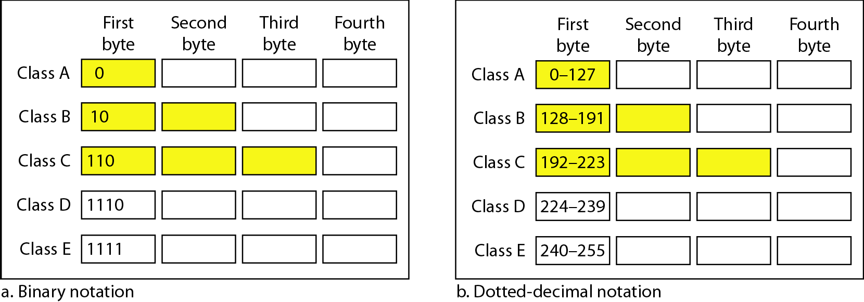
Finding the classes in binary and dotted-decimal notation
Classful addressing contd…
Classful addressing

Slide 18
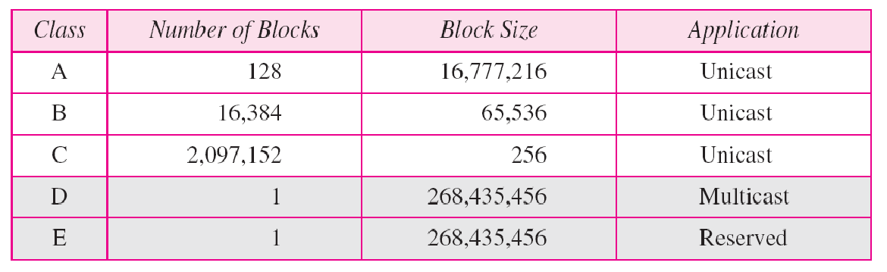
Number of blocks and block size in classful IPv4 addressing
Classful addressing contd…

Slide 19
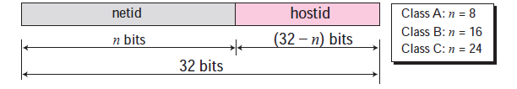
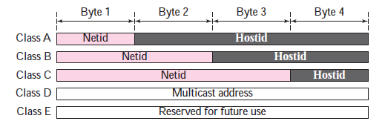
Classful addressing contd…
Netid and Hostid
In classful addressing, an IP address in class A, B, or C is divided into netid and hostid.
These parts are of varying lengths, depending on the class of the address.
Classes D and E are not divided into netid and hosted.
In class A, one byte defines the netid and three bytes define the hostid.
In class B, two bytes define the netid and two bytes define the hostid.
In class C, three bytes define the netid and one byte defines the hostid.

Slide 20
Example 19.4
Find the class of each address.
a. 00000001 00001011 00001011 11101111
b. 11000001 10000011 00011011 11111111
c. 14.23.120.8
d. 252.5.15.111
Solution
a. The first bit is 0. This is a class A address.
b. The first 2 bits are 1; the third bit is 0. This is a class C address.
c. The first byte is 14; the class is A.
d. The first byte is 252; the class is E.

Slide 21
Classful Addressing
Problems
1. Find the class of each address:
a. 00000001 00001011 00001011 11101111
b. 11000001 10000011 00011011 11111111
c. 10100111 11011011 10001011 01101111
d. 11110011 10011011 11111011 00001111

Slide 22
Classful Addressing
Problems
2. Find the class of each address:
a. 227.12.14.87
b. 193.14.56.22
c. 14.23.120.8
d. 252.5.15.111

Slide 23
IPv4 Address
Problems on Range of Address
1. Find the number of addresses in a range if the first address is 146.102.29.0 and the last address is 146.102.32.255.
Sol: We can subtract the first address from the last address in base 256.
The result is 0.0.3.255 in this base.
To find the number of addresses in the range (in decimal), we convert this number to base 10 and add 1 to the result.

Slide 24
IPv4 Address
Problems on Range of Address
2.The first address in a range of addresses is 14.11.45.96. If the number of addresses in the range is 32, what is the last address?
Sol: We convert the number of addresses minus 1 to base 256, which is 0.0.0.31. We then add it to the first address to get the last address. Addition is in base 256.

Slide 25
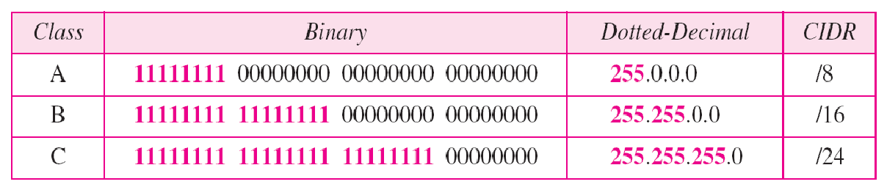
Classful addressing contd…
Network Mask
The routers in the Internet normally use an algorithm to extract the network address from the destination address of a packet. To do this, we need a network mask.
A network mask or a default mask in classful addressing is a 32-bit number with n leftmost bits all set to 1s and (32 − n) rightmost bits all set to 0s.
Network Address = AND(IP, Network Mask)

Slide 26
IPv4 Address : Bitwise Operations…
2. Bitwise AND Operation
The AND operation compares the two corresponding bits in two inputs and selects the smaller bit from the two.
We can use two short cuts.
When at least one of the numbers is 0 or 255, the AND operation selects the smaller byte (or one of them if equal).
When none of the two bytes is either 0 or 255, we can write each byte as the sum of eight terms, where each term is a power of 2. We then select the smaller term in each pair (or one of them if equal) and add them to get the result.

Slide 27
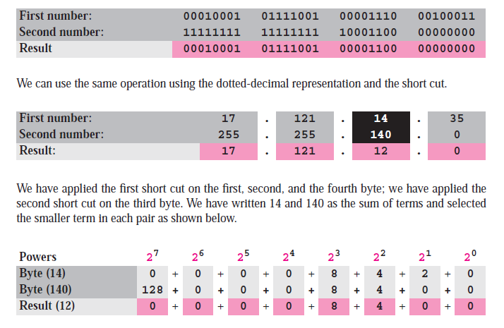
IPv4 Address : Bitwise Operations…

Slide 28
Example
An address in a block is given as 200.11.8.45. Find the number of addresses in the block, the first address, and the last address.
Solution:
Given IP : 200.11.8.45
Class : C
Network Mask : 255.255.255.0
IP : 200 . 11 . 8 . 45
N/w addr (or) First address : 200 . 11 . 8 . 0 ← [ AND(IP, Network Mask) ]
Broadcast addr (or) Last address : 200 . 11 . 8 . 255
Total no. of addresses in a block : 2^n = 2^8 = 256
Total no. of Host addresses : (2^n)-2 = 256 – 2 = 254

Slide 29
4. Classless addressing
To overcome address depletion and give more organizations access to the Internet, classless addressing was designed and implemented.
Here are no classes, but the addresses are still granted in blocks.
Address Blocks
In classless addressing, when an entity, small or large, needs to be connected to the Internet, it is granted a block (range) of addresses.
The size of the block (the number of addresses) varies based on the nature and size of the entity.

Slide 30
Classless addressing contd…
Restriction: To simplify the handling of addresses, the Internet authorities impose three restrictions on classless address blocks:
The addresses in a block must be contiguous, one after another.
The number of addresses in a block must be a power of 2 (I, 2, 4, 8, ... ).
The first address must be evenly divisible by the number of addresses.

Slide 31
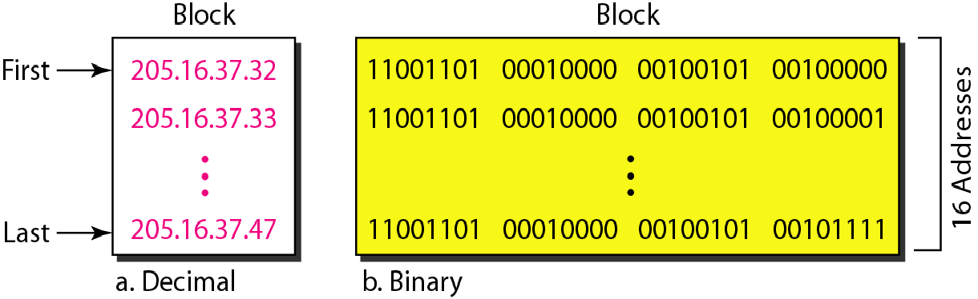
A block of 16 addresses granted to a small organization
Classless addressing contd…

Slide 32
Classless addressing contd…
Mask
In classless addressing the mask for a block can take any value from 0 to 32. It is very convenient to give just the value of n preceded by a slash (CIDR notation)
/n [denotes the prefix length]
/(n-32) [denotes the suffix length]
In IPv4 addressing, a block of addresses can be defined as
x.y.z.t /n
x.y.z.t → defines one of the addresses
/n → defines the mask.

Slide 33
Classless addressing contd…
The first address in the block can be found by setting the rightmost
32 − n bits to 0s.
The last address in the block can be found by setting the rightmost
32 − n bits to 1s.
The number of addresses in the block
can be found by using the formula
₂32−n.

Slide 34
Example
1. A block of addresses is granted to a small organization. We know that one of the addresses is 205.16.37.39/28. What is the first address in the block?

Slide 35
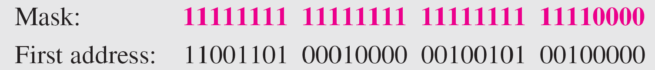
Solution
A block of addresses is granted to a small organization. We know that one of the addresses is 205.16.37.39/28. What is the first address in the block?
Solution
The binary representation of the given address is
11001101 00010000 00100101 00100111
Method 1: If we set 32−28 rightmost bits to 0, we get the first address.
11001101 00010000 00100101 00100000 or 205.16.37.32.
Method 2: AND(IP address, Network Mask)

Slide 36
Example
2. Find the last address for the block

Slide 37
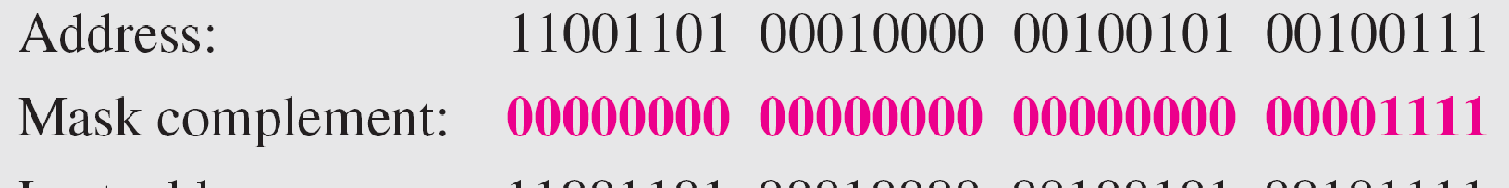
Solution
Find the last address for the block.
Solution
The binary representation of the given address is
11001101 00010000 00100101 00100111
Method 1: If we set 32 − 28 rightmost bits to 1, we get the last address.
11001101 00010000 00100101 00101111 or 205.16.37.47
Method 2: OR(IP address, Complement of Mask)

Slide 38
example
3. Find the number of addresses in the given Example.
Solution
The value of n is 28, which means that number of addresses is 2³²⁻²⁸ or 16.

Slide 39
SELF-ASSESSMENT QUESTIONS
In a block of addresses, we know IP address of one host is 25.34.12.56/16. What is the first address (network address) and the last address (limited broadcast address) in this block?
Find the block if one of the addresses is 190.87.140.202/29
In a network the address of one computer is 201.78.24.56 and the address of another computer is 201.78.120. 202. How many addresses are in between?
What is the main difference between IPv4 and IPv6?
What are the key advantages of IPv6 over IPv4?

Slide 40
REFERENCES FOR FURTHER LEARNING OF THE SESSION
Reference Books:
1. Data Communications and Networking, Behrouz A. Forouzan, 4th Edition, McGraw Hill.
2. Computer Networks, Tanenbaum, 6th Edition, Pearson.
Sites and Web links:
CISCO Academy
NPTEL, Computer Networks and Internet Protocols, Prof. Soumya Kanti Ghosh, Prof. Sandip Chakraborty IIT Kharagpur. (https://nptel.ac.in/courses/106105183)

Slide 41
THANK YOU
Team – Networks Protocols & Security

